Slide 1
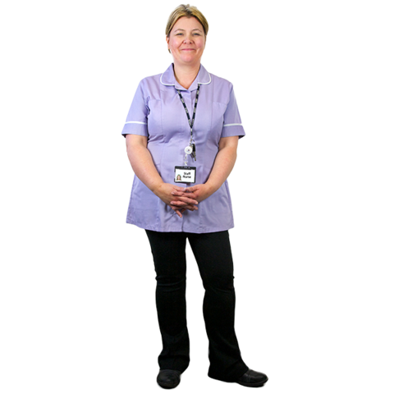
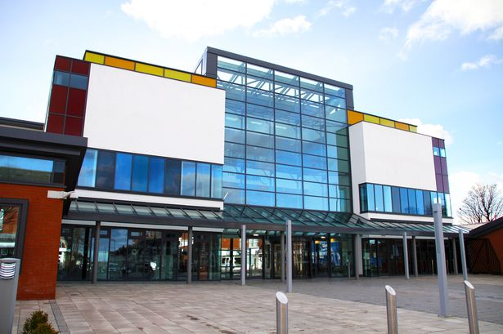
North East Regional Access to Acute Network
Get Together to be Happy and Healthy
The Access to Acute and the Good Access to Primary services networks would like to invite you to our conference about how friendships and relationships support people in their health
When: Friday 7 October 2016
Time: 09.45am till 3.15pm
Where: The Beacon, Westgate Road, Newcastle, NE4 9PQ
On the day we will be:
Talking about friendships and relationships and how they can help keep you healthy
Talking about safe relationships
Having some fun workshops
Having lunch
Helping people make friends
OCTOBER
7
09.45 am
3.15 pm
If you would like to come please let your acute liaison nurse or primary care facilitator know

